Slide 1
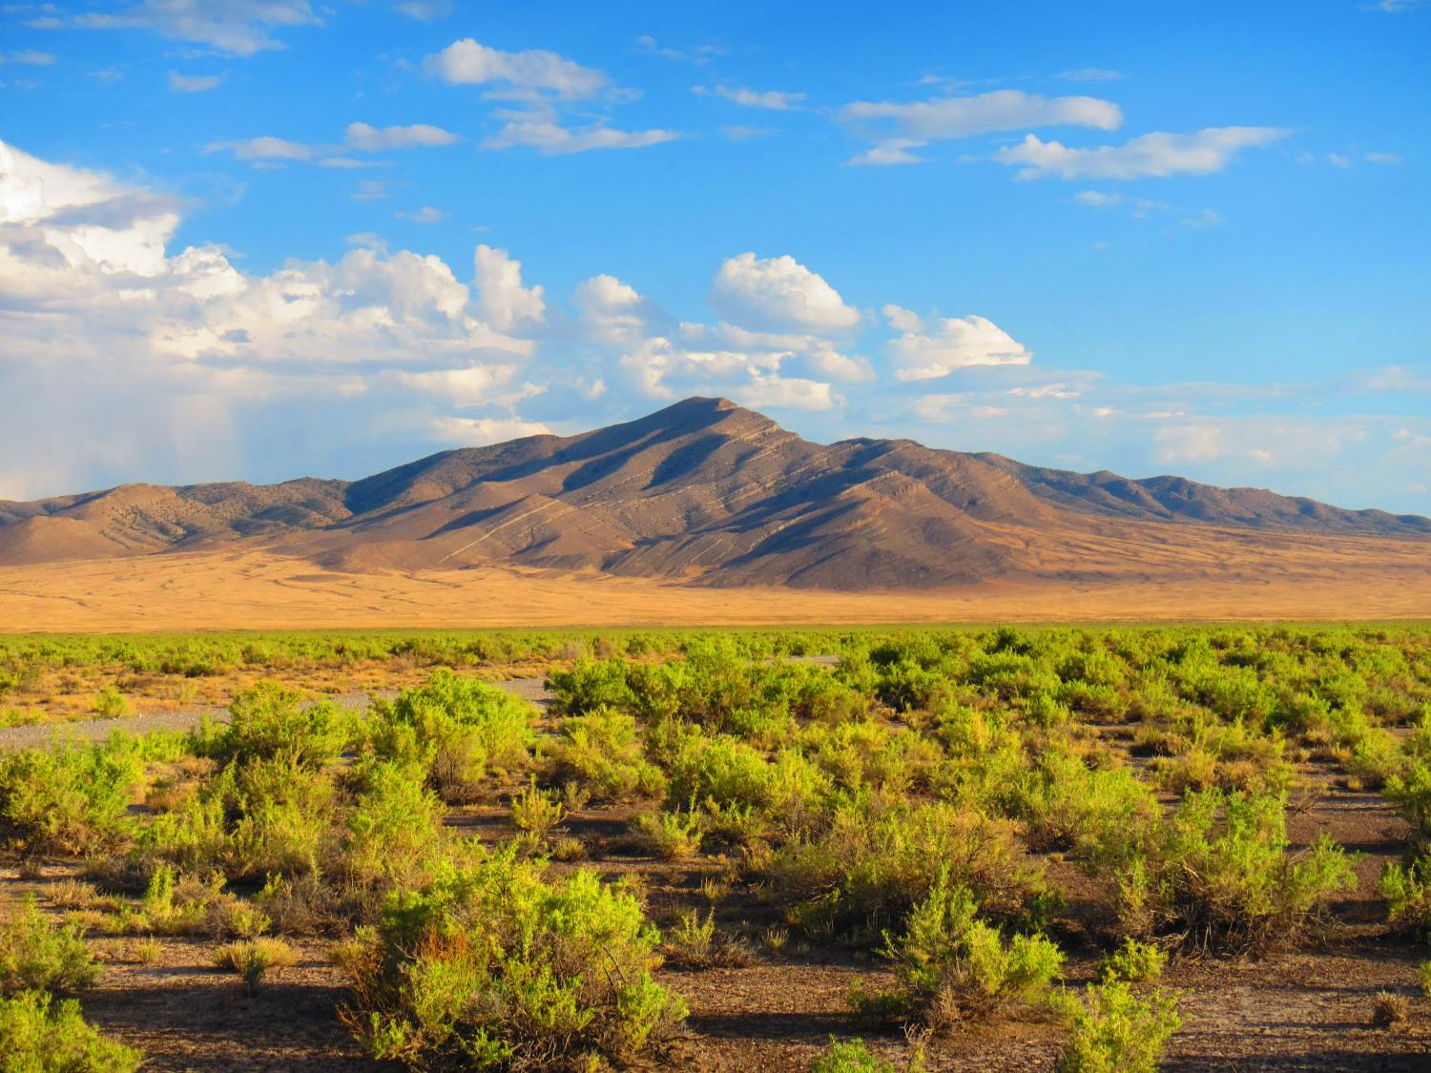

Digital Soil Mapping and Ecological Site Descriptions: the potential
Colby Brungard - Graduate Student Utah State University
Jamin Johanson - NRCS-UT Rangeland Specialist
Notes:
Currently working on a project to test some of these ideas, Jamin will discuss this further.

Slide 2
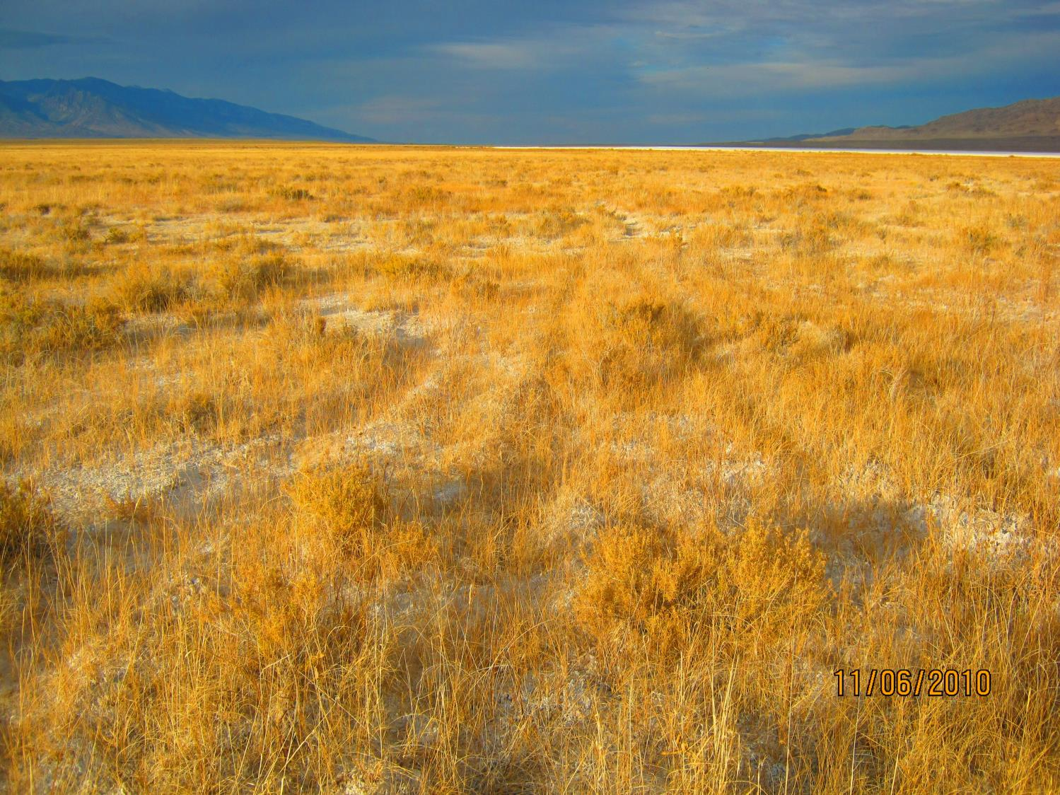
Why you should listen to this!
Digital soil mapping (DSM) can:
Help refine ecological site descriptions
Delineate locations

Slide 3
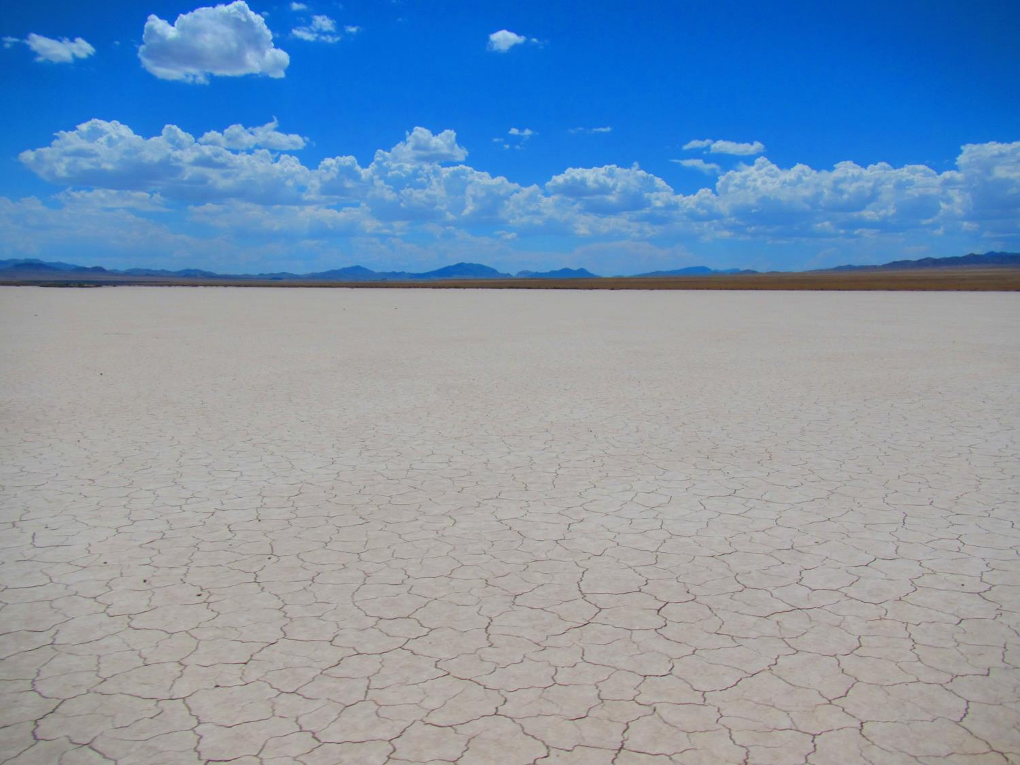
What is Digital Soil Mapping?
Soil = f(CLORPT); Jenny, 1941
How to solve?
Geospatial information (GIS)
New ways to define CLORPT variables
Digital elevation models
Remotely sensed imagery
Geology maps
Climate surfaces

Slide 4
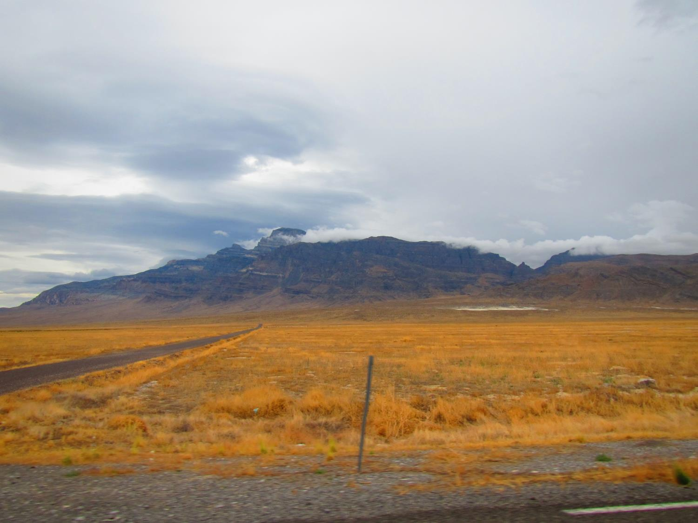
What is Digital Soil Mapping (cont.)?
S = f(SCORPAN); McBratney et al. 2003
S = soil
C = climate
O = organisms
R = relief
P = parent material
A = age
N = spatial location
Specifically for geospatial data
What about f ?
Classification
Regression
Knowledge based

Slide 5
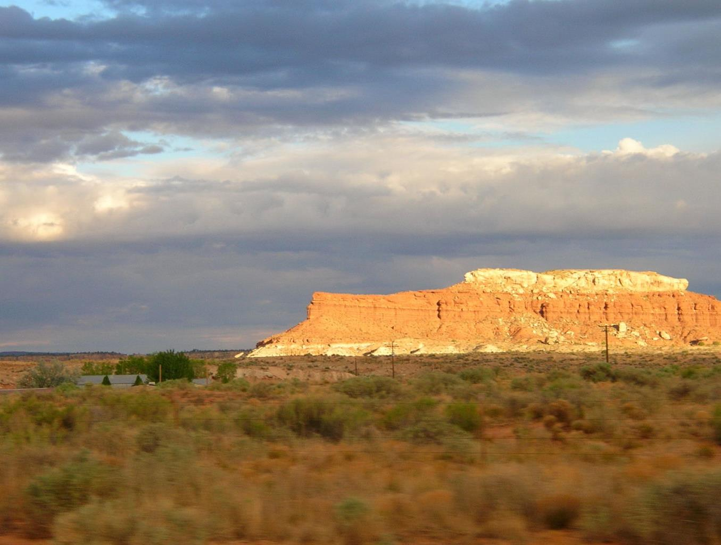
Potential Products
Raster maps
Better representation of soil variability
Sub-map unit
Quantify uncertainty
Potential to map in 3D (time ?)

Slide 6
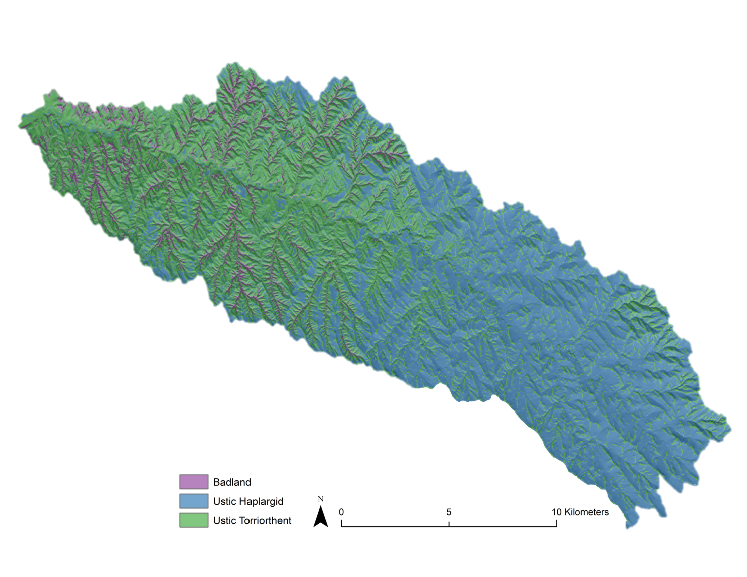
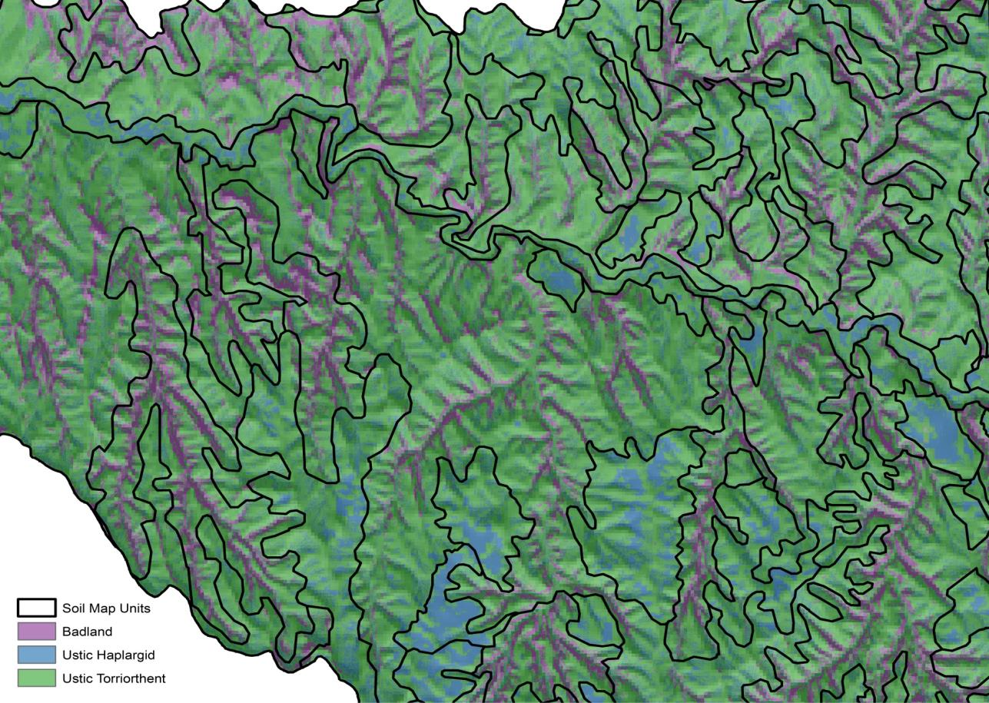
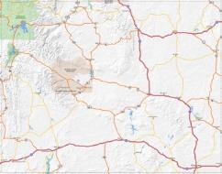
Examples: Powder River Breaks, WY

Slide 7
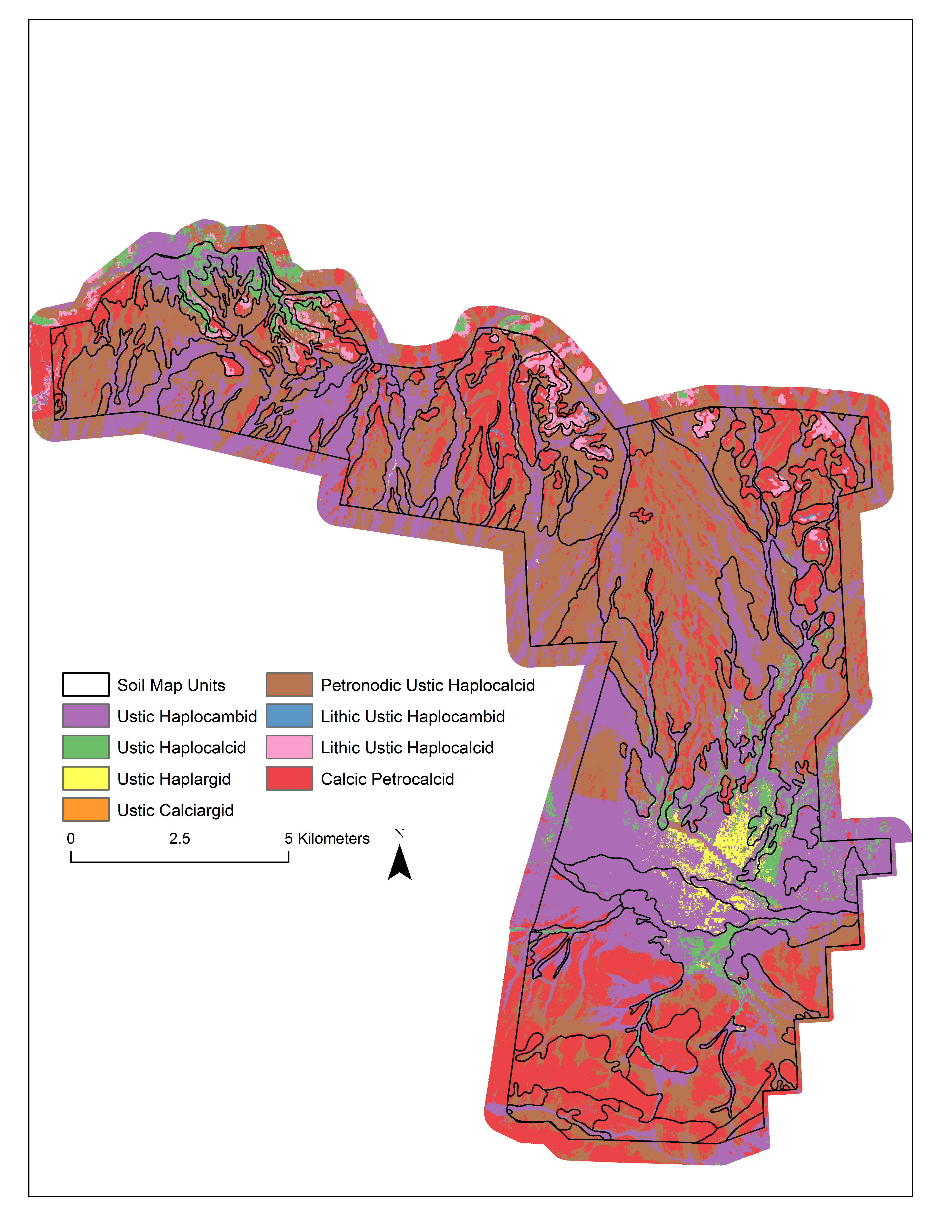
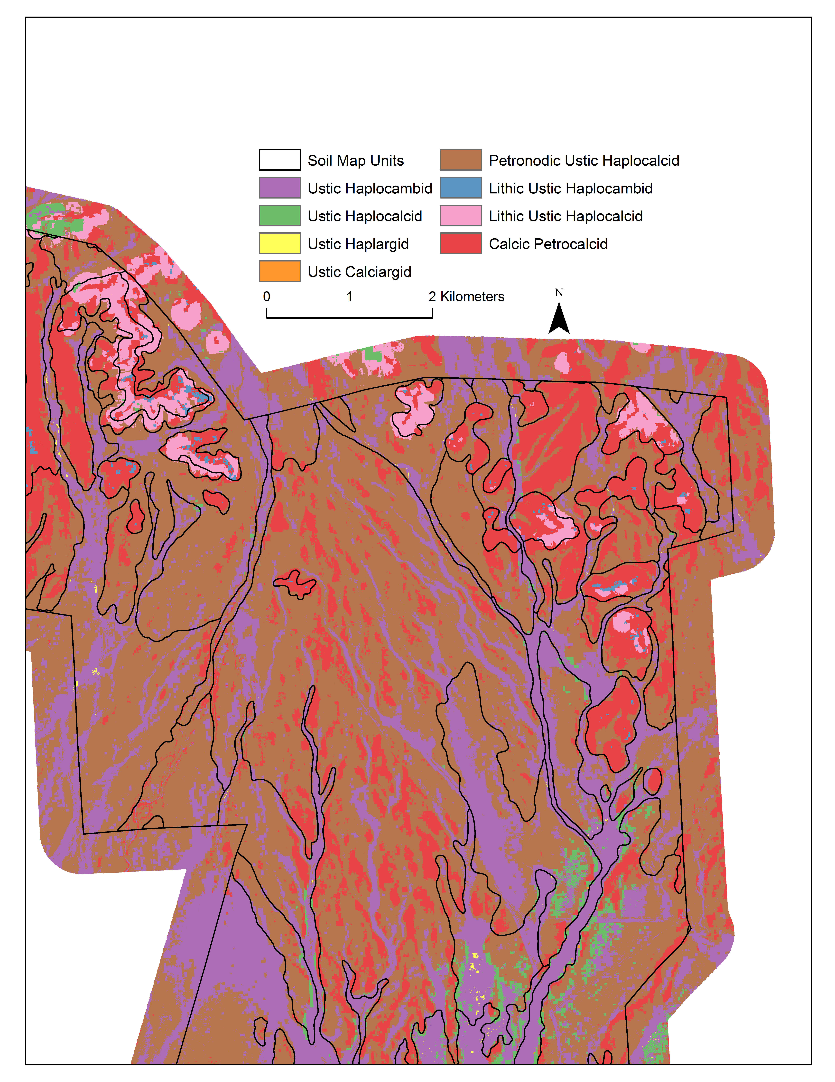
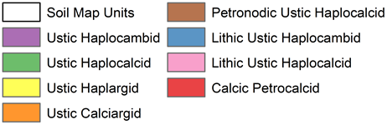
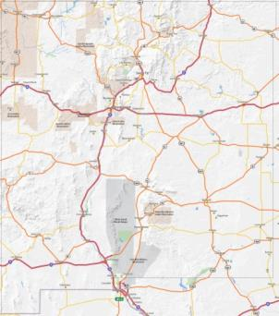
Example: Ft. Bliss NM

Slide 8
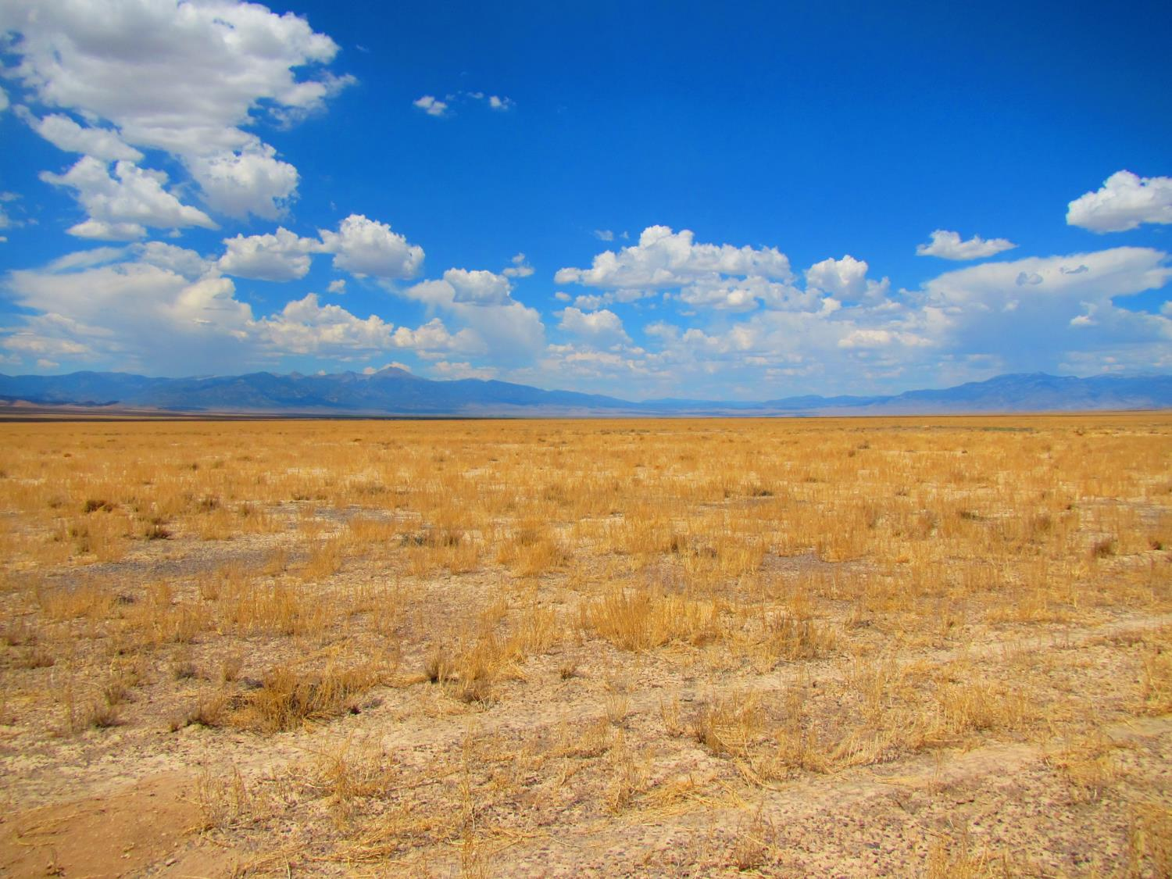
What might Digital Soil Mapping do for Ecological Site Descriptions ?
Mapping soil classes
Sub-map unit predictions
Order 3-5 soil maps
Map soil properties (depth, texture, etc.)
Refine ecological site descriptions
Range of variability
Histograms
Most important environmental features
Independent ESD maps?
Notes:
For areas with order 3-5 soil mapping, DSM can map soils at a sub-mapunit level, which could help produce more accurate soils-based ESD maps for geospatial analyses.
DSM can help refine the range of variability of soils parameters that characterize an ESD
Histograms and summary statistics generated by DSM can be used to identify ESD parameters that are bimodal, too broad, or sites that are potentially misclassified.
DSM can help identify which environmental features are most important when trying to distinguish between similar sites.
DSM could potentially be used to generate an “independent” ESD map by running the raster products through and Ecosite key. Start with the MLRA and LRU designation for each raster cell, then start keying out each raster cell based on soil depth, moisture and temp regime, percent rock frags, texture, pH, and all other raster layers you have available.
Then validate such maps with existing ESD maps and propose field validation points to test.

Slide 9
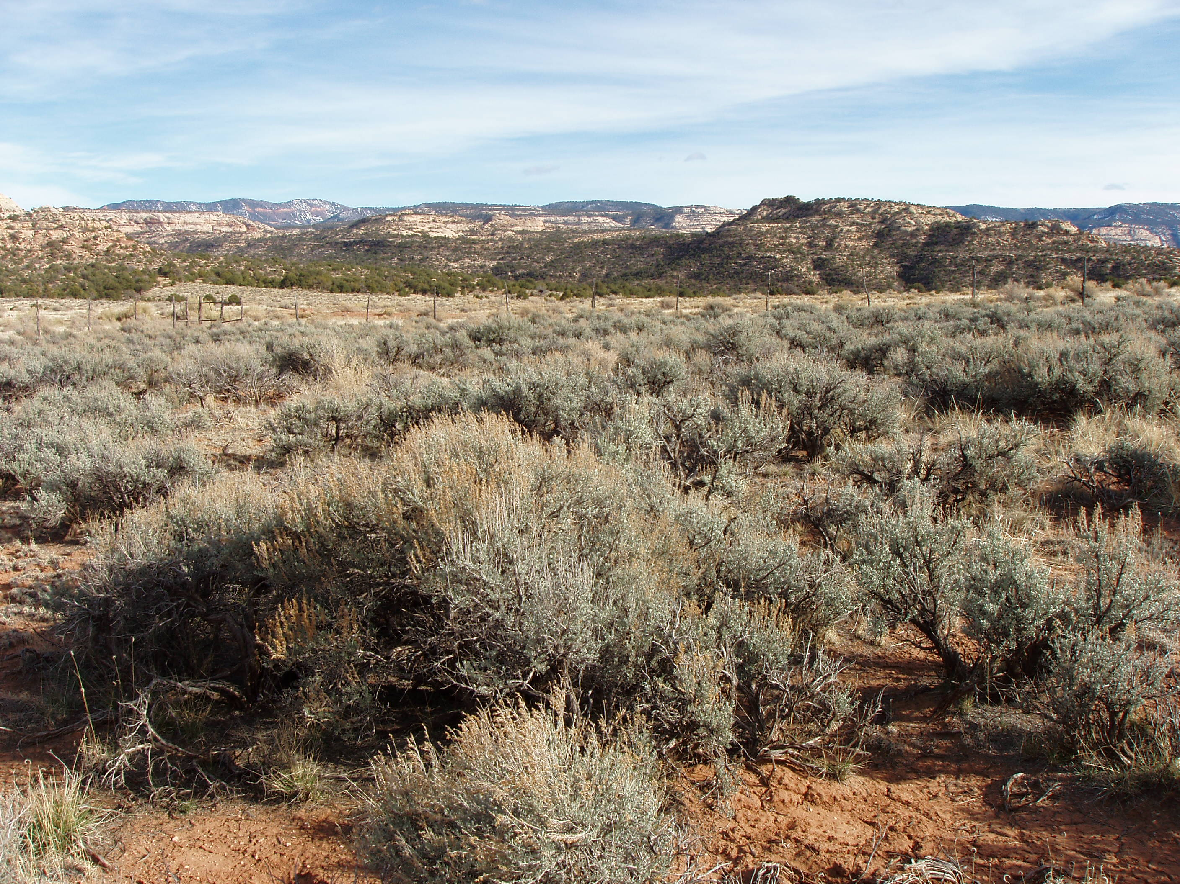
Refining ESD Concepts with DSM
Notes:
Okay, thanks Colby for that brief introduction to what is a very complex, emerging technology in the soil science discipline. I like Colby’s examples because they show how his projects creating raster-based soil maps generate powerful information that could really be utilized in defining, refining, and delineating ecological sites on the landscape.

Slide 10
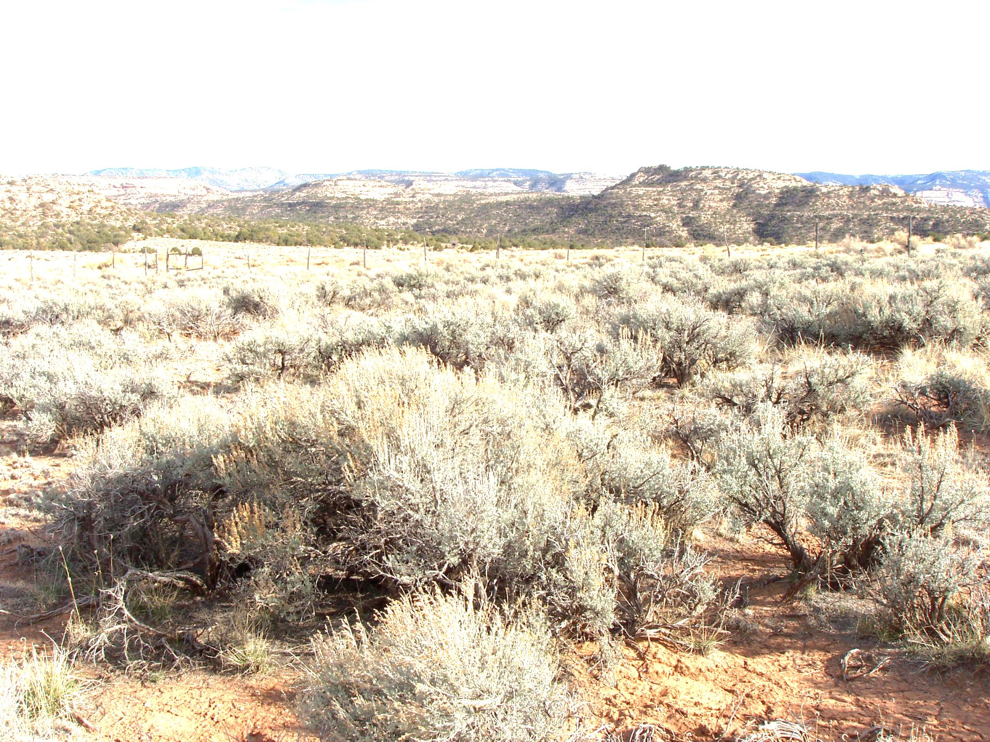
ESDs summarize landscape variability
ESDs are powerful because they summarize important and repeatable landscape patterns
ESDs are limited when site concepts overlap, such that one site is easily confused with another
We often lack sufficient data to consistently distinguish ES based on edaphic features
DSM can help define and refine the range of variability of important soil properties.
Notes:
ESDs are powerful tools, however, when ecological site concepts overlap such that one site is easily confused with another, they lose their power to interpret the landscape. In other words, ESDs are conceptual divisions of the landscape, and the stronger the ESD concepts are in distinguishing one site from another, the more powerful ESDs will be to interpret and predict what is happening on the landscape. DSM provides one more source of information that can help us strengthen Ecosite concepts.

Slide 11
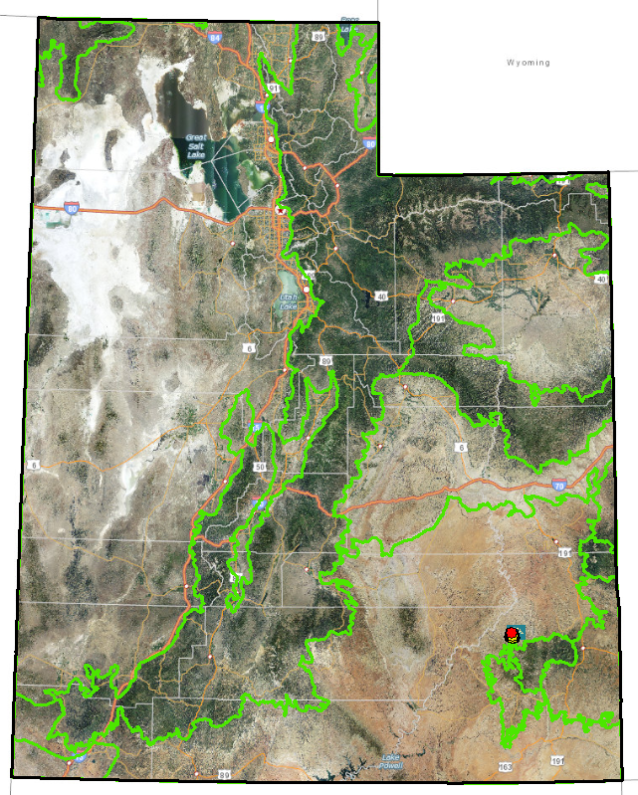
Refining ESD Concepts with DSM
Semidesert Sandy Loam (Wyoming big sagebrush)
Site R035XY216UT
Beef Basin
Study Area
Notes:
So I want to provide with a very simple example of how mapping soil properties using DSM are helping us, in Utah, better understand and describe the differences between two very similar ESDs in the Colorado plateau. On the map, the green lines are MLRA lines, and there are two very similar ecological sites that occur throughout MLRA 35. One of the sites is pictured here, the Semidesert Sandy Loam (Wyoming big sagebrush) site. It occurs on deep sandy loam soils in the 8-12” precipitation zone.

Slide 12
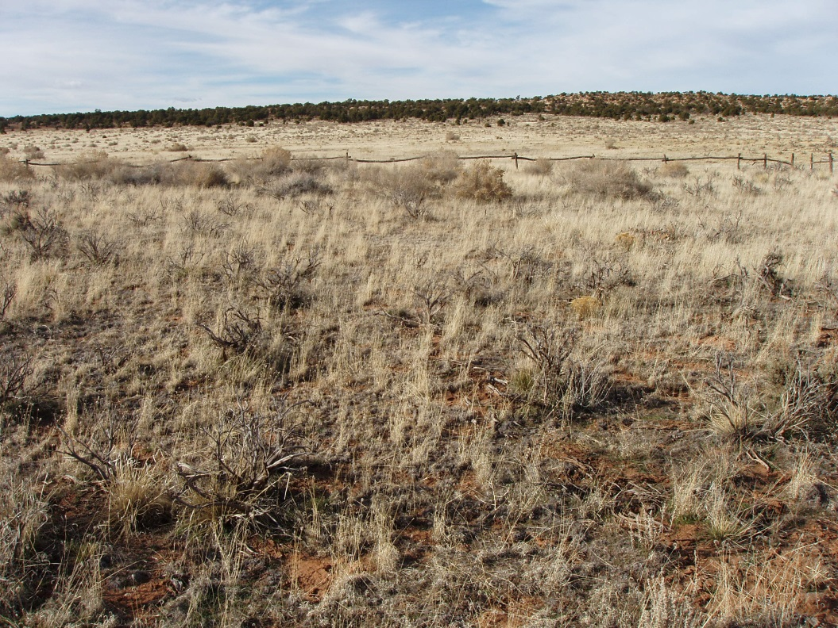
Refining ESD Concepts with DSM
Semidesert Sandy Loam (Fourwing Saltbush)
Site R035XY215UT
Beef Basin
Study Area
Notes:
Here, in the very same area, on the same, or very similar, landforms, is the Semidesert Sandy Loam (Fourwing saltbush) ecological site. It also occurs on deep sandy loam soils with few rock fragments in the 8-12” precipitation zone. At this point I would like to point out that these two sites do not always occur together on the landscape, in which case it is easier to tell them apart. But in areas like beef basin, the sagebrush and fourwing saltbush sites occur together in complex, and we have not had any evidence up to this point as to what it is, specifically, about the soils that makes these two sites exhibit different plant community phases and even different states in the STM.

Slide 13

Refining Ecosite Concepts with DSM
What is the difference between these two ESs?
Same, precipitation zone, soil texture, depth, rock fragments, etc.
Even correlated to some of the same soil series!
But, the reference plant communities and STMs are different
Semidesert Sandy Loam (Fourwing saltbush)
Semidesert Sandy Loam (Wyoming big sage)
Site 215
Site 216
Notes:
So, here are the two sites side by side. On the left is the Semidesert Sandy Loam (4 wing) site, and on the right is the Semidesert Sandy Loam (Wyoming big sagebrush) site. The ESDs tell us that both sites occur in the same precipitation zone, and the range of variability in soil textures, depths, rock fragments, etc. are pretty much identical for the two sites. There is a difference, as I mentioned, in the site potential and response to management. Site 215 cannot support sagebrush, but typically has sparse fourwing saltbush and is dominated by perennial warm and cool season grasses. 215 is typically too dry to be susceptible to Utah juniper invasion, but it can become dominated by invasive annual forbs like Russian thistle. Site 216, on the other hand, supports sagebrush with some 4 wing saltbush scattered throughout, and unlike 215 it is susceptible to juniper invasion and dominance. Yet, our current measurements and descriptions of soils features have not been able to detect a consistent difference between the soils of these two ecological sites. Now, we know that sagebrush requires more moisture than fourwing saltbush, so we suspect that there may be some measure of increased water holding capacity on the soils with sagebrush, but it is a subsurface change in texture, or some other water-holding soil property? We are also open to the idea that these two ecological sites may not be different sites at all, but simply phases of the same site. Yet, so far the evidence suggests that there are some significant differences in site potential and response to management going on here.

Slide 14
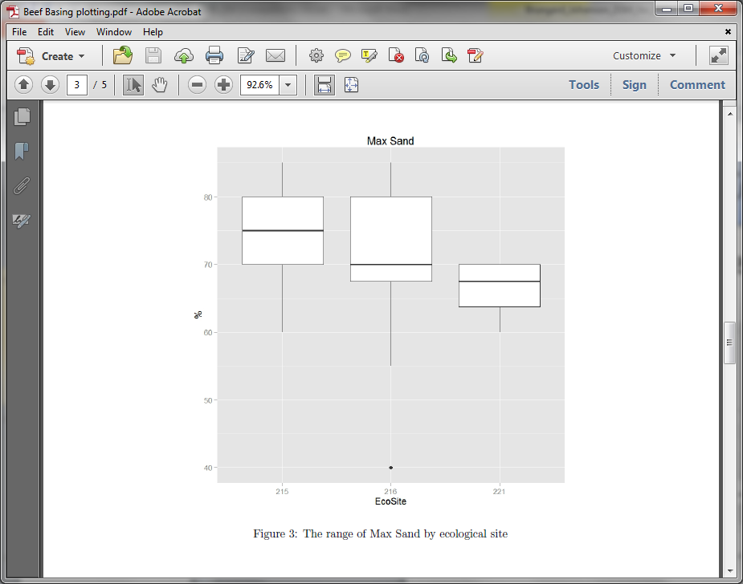
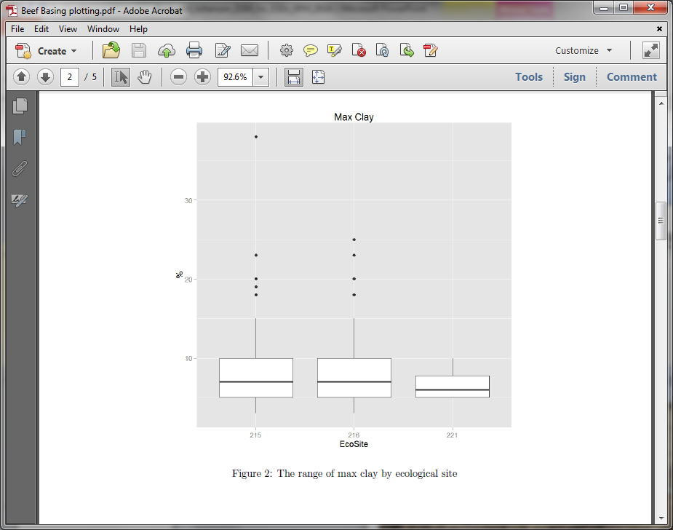
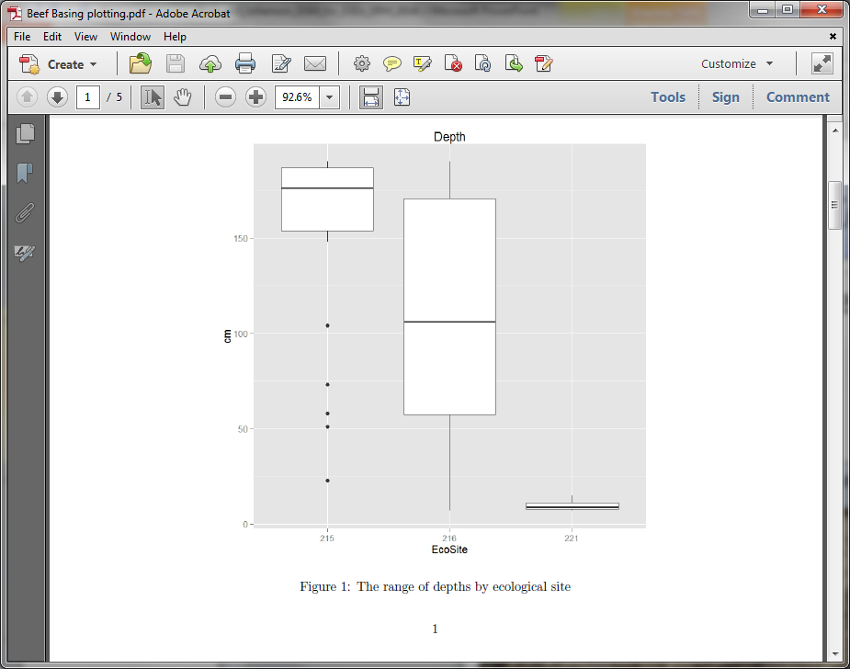
Refining Ecosite Concepts with DSM
What is the difference between these two ESs?
Max Sand %
Max Clay %
Soil Depth
Site215
Site216
Site221
Site215
Site216
Site221
Site215
Site216
Site221
Notes:
So, several researchers are interested in the plant community dynamics in the beef basin area, and Gene Schuppe’s lab from USU has been particularly gracious in allowing us to use their soils and vegetation data to explore the differences between these two ecological sites. These bar graphs represent the variability in soil textures and soil depth at about 97 points on three ecological sites in the beef basin area. We are mostly interested in site 215 and 216, with site 221 being a very shallow PJ site that just happened to occur on about 5 of the points in the dataset. The ESD was assigned to site 215 or site 216 based on the presence or absence of big sagebrush, since the site descriptions tell us that site 215 is incapable of producing sagebrush. Sites that had only grasses were difficult to assign, but were put into site 215 because it is typically more of a grassland site. Notice that the two texture variables analyzed show that subsoil sand and clay percent are very similar between the site 215 and site.

Slide 15
Refining Ecosite Concepts with DSM
What is the difference between these two ESs?
Max Sand %
Max Clay %
Soil Depth
Site215
Site216
Site221
Site215
Site216
Site221
Site215
Site216
Site221
Notes:
However, soil depth seems to be different between the two sites (also 221 is consistently very shallow and PJ dominated). The fourwing site, 215, has an average max soil depth of about 175 cm, while the sagebrush site has an average max soil depth of about 100 cm. What that means is that on fourwing sites, the soil scientists stopped digging at about 175 cm, but on the sagebrush sites, soil scientists stopped digging when they hit a bedrock layer at an average depth of 100 cm. So our new working hypothesis, at least in beef basin, is that perhaps a bedrock layer helps perch water in the plant rooting zone on the sagebrush site, while the lack of bedrock in the fourwing site allows water to percolate beyond the plant rooting zone in these coarse textured soils. This hypothesis could also explain why juniper can establish and dominate on the sagebrush site, but not on the very deep, drier fourwing site. In both cases the soils are typically deep, just as the ESD described, but these data suggest that there may be a significant difference between deep to bedrock and very deep to no bedrock distinguishing these two sites.

Slide 16
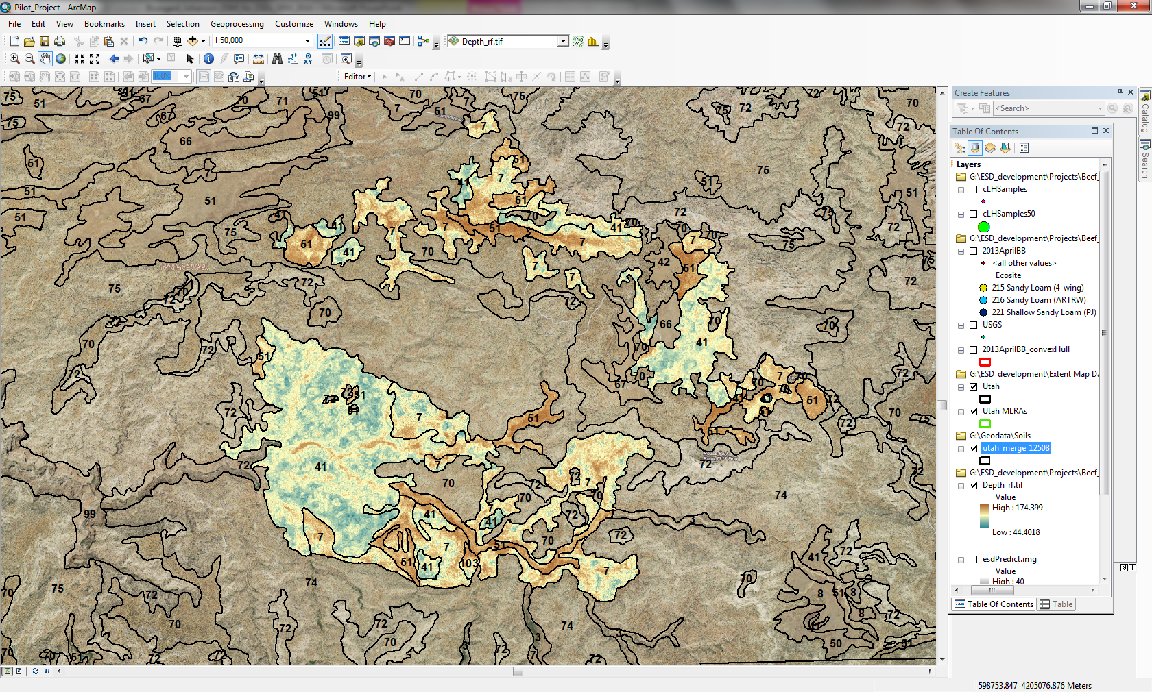
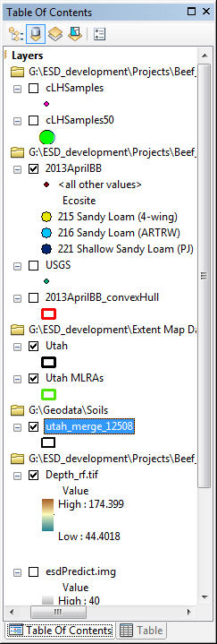
Refining Ecosite Concepts with DSM
So how does Digital Soil Mapping help?
3 soil map units are shown:
41— 1 major component
Sagebrush ESD (216)
51—1 major component
Fourwing ESD (215)
7—2 major components
Sagebrush ESD (216)
Fourwing ESD (215)
Notes:
So, given that hypothesis, Colby produced a digital map of a single soil property, soil depth, to predict where sites 215 and sites 216 are most likely to occur on the landscape. You can see from the map that we limited the predictions to only the 3 soil map units for which we had data to inform the model. The blue represents areas with relatively shallower soils, while the brown represents areas with relatively deeper soils, and the yellowish-tan areas are somewhere in between. Remember that none of these areas are necessarily shallow, taxanomically speaking; the darker blue areas are roughly mod-deep to bedrock, with yellow as deep to bedrock, and dark brown as very deep soils with no bedrock contact. Also, keep in mind that this is a preliminary map that we are using to gather additional evidence to help us distinguish between 2 very similar ecosites that have not been distinguishable in any consistent way up to this point. Now, this is in no way intended to replace our current methods of ESD development in Utah, but rather it is an additional tool we are using to help us better understand and describe the variability within ecological sites, and their distinguishing features.

Slide 17
Refining Ecosite Concepts with DSM
So how does Digital Soil Mapping help?
3 soil map units are shown:
41— 1 major component
Sagebrush ESD (216)
51—1 major component
Fourwing ESD (215)
7—2 major components
Sagebrush ESD (216)
Fourwing ESD (215)
Notes:
If we zoom in a little bit, we can see that this map shows nicely the relationship between soil depth, soil map unit and ecological site. Notice that all of the areas with a lot of blue occur in SMU 41, which has 1 major soil component and is correlated to sagebrush. All of the areas with a lot of brown occur in SMU 51, which has 1 major soil component and is correlated to fourwing saltbush. SMU 7 has 2 major soil components, one that is correlated to sagebrush, and 1 that is correlated to fourwing saltbush. Notice that SMU 7 generally has a mix of brown and blue in each of its delineations. So at a sub mapunit scale, DSM allows us to predict where an ecological site is likely to occur. It doesn’t replace the SMUs or ESD correlations, but it adds additional information to help us understand and perhaps describe the variability that occurs on the site.

Slide 18
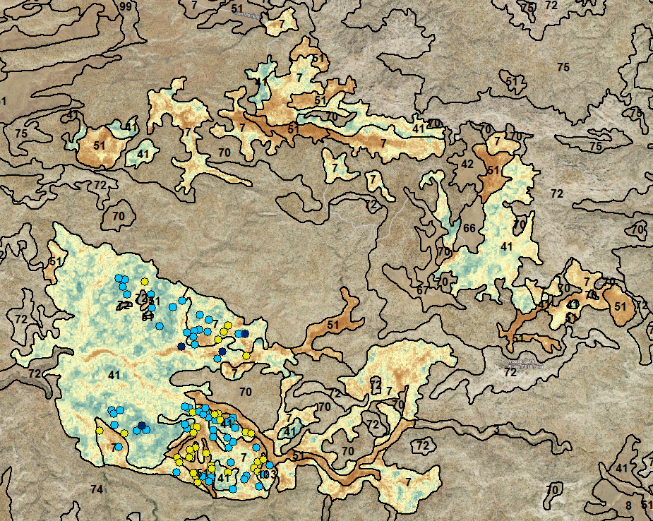
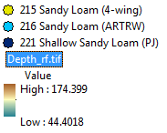
Refining Ecosite Concepts with DSM
So how does Digital Soil Mapping help?
3 soil map units are shown:
41— 1 major component
Sagebrush ESD (216)
51—1 major component
Fourwing ESD (215)
7—2 major components
Sagebrush ESD (216)
Fourwing ESD (215)
Notes:
If we add the soil pit locations to the map, you’ll notice that all of the points in this model are from the southern half of the area. Next year, more data points will be taken in the northern half of the area that can be used to validate the accuracy of these model predictions. This small project is still in the beginning stages, and it is actually a very small part of a much larger collaborative effort in the beef basin area to explore how much information DSM is capable of contributing to ecological site development. We just wanted to give you a feel for what DSM is, and how it can be used for ESD development. At this point, we don’t know exactly how far we can take DSM technology in the ESD world, but we believe it has a lot of potential, especially for areas like the western U.S. that have a lot of ecological variability and relatively coarse scale (order 3-5) soil surveys. DSM may have the power to explain ecological variability better than we currently are with aggregated soils data.

Slide 19
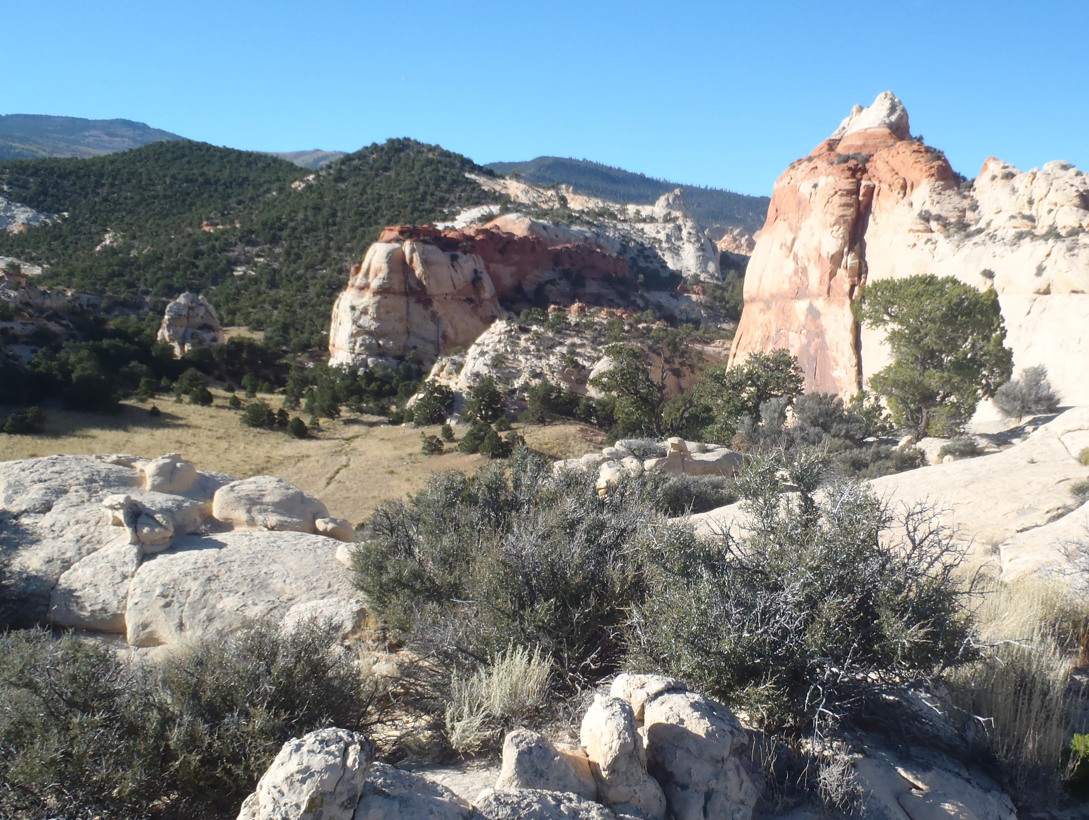
Questions?
Colby Brungard— c.w.b@aggiemail.usu.edu
Jamin Johanson—jamin.johanson@ut.usda.gov
Notes:
This short talk is really just the tip of the iceberg for this emerging technology, so please don’t hesitate to contact me or Colby if you have interest or experience in digital soil mapping as it applies to ecological site development. Thank you, and I’ll be happy to take any questions.

